Slide 1
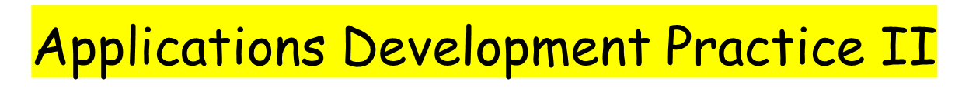

17 May 2021
Radford Burger

Slide 2

What do we already know?
Polymorphism
  with unrelated classes (Employee example with interfaces)
  Interfaces and event-handling (Lotto Gui example)

Slide 3
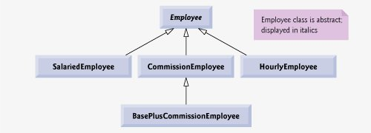
What do we already know about polymorphism?
Contains abstract method pay( )
Subclasses override method pay( )

Slide 4

What do we already know about polymorphism?
the ability of one object to be treated, or used, like another.
the capability of an action or method to do different things based on the object that it is acting upon
enables us to write programs that process objects that share the same superclass in a class hierarchy as if they are all objects of the superclass.

Slide 5

<abstract>
Employee
-abstract pay()
Hourly
-pay()
Salaried
-pay()
Supplier
-pay()
What happens if we have another class called Supplier?
A supplier has a name and also needs to be paid.
Let’s look at Employee application again

Slide 6

when a class implements an interface, the class makes a contract with the compiler stating either
that the class will override each of the methods in the interface
or that the class will be declared abstract
or any concrete subclass of the abstract class must override the interface methods

Slide 7

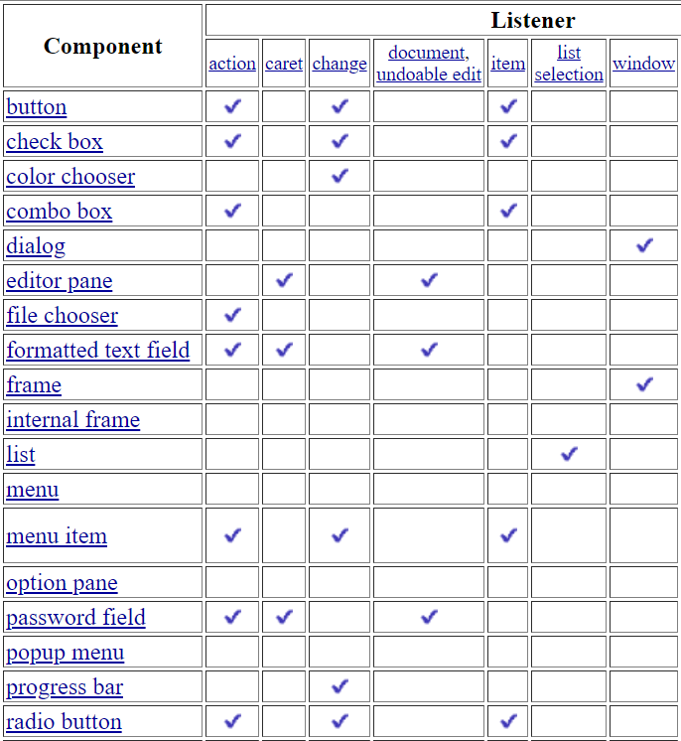

Slide 8
JButton
  public void addActionListener(ActionListener a){}
JMenuItem
  public void addActionListener(ActionListener a){}
JTextField
  public void addActionListener(ActionListener a){}
  public void addTextListener(TextListener a){}
JTextArea
  public void addTextListener(TextListener a){}
JCheckbox
  public void addItemListener(ItemListener a){}
JCombobox
  public void addActionListener(ActionListener a){}
  public void addItemListener(ItemListener a){}
Let’s look at LottoGui application again

Slide 9
Java does not support multiple inheritance with classes.
However, a subclass can implement more than one interface.
We can therefore simulate multiple inheritance if we combine the use of interfaces and classes.

Slide 10

Exception-handling
File-handling (sequential text files)

